Slide 1
PROJECT PRESENTATION
Syed Huzaifa Nabeel
The CLI Bank
A terminal-based banking application, built with a four-layer architecture connected to a Postgres database.
API
Service
Persistence
Domain
Notes:
Title slide, presented in first person: "Today I'm walking through Bank of CLI, the banking app I built for this project."

Slide 2
ARCHITECTURE
Layered Architecure
01 · api
BankCLI, Main — terminal menu and user input
↓ calls
02 · service
BankService, BankServiceImpl — the banking rules
04 · domain
↓ calls
Account, Transaction
03 · persistence
AccountDAO, TransactionDAO, ConnectionFactory — talks to Postgres
Plain model classes shared across all three layers — the common language everyone speaks.
↓ persists
DB · postgres
accounts and transactions tables
API never talks to Persistence directly.
Notes:
Explain the fourth layer: Domain isn't in the call chain like the other three — it's the shared model layer every other layer imports, which is why it's drawn beside the pipeline rather than inside it.

Slide 3
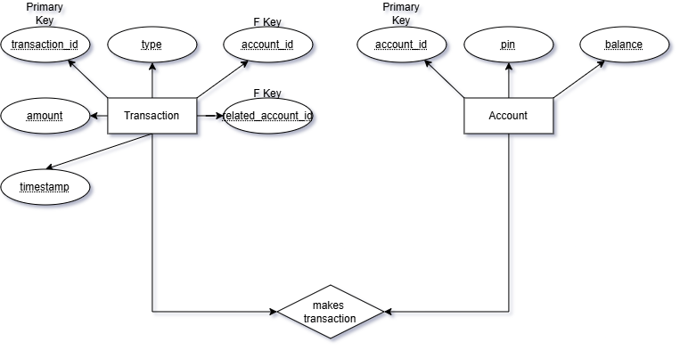
DATA MODEL
ER Diagram
The CLI Bank · Data model
Notes:
Two relationships between the same pair of tables: every transaction has exactly one owning account (solid line), and only transfers also have a counterparty account (dashed line, nullable).

Slide 4
CODE TOUR
com.bankcli, package by package
api/
service/
persistence/
domain/
BankCLI.java
BankService.java
AccountDAO.java
Account.java
Main.java
BankServiceImpl.java
AccountDAOImpl.java
Transaction.java
TransactionDAO.java
TransactionDAOImpl.java
ConnectionFactory.java
The CLI Bank · Package structure
Notes:
Walk the folders left to right in the order a request flows: api receives input, service applies rules, persistence hits the database, and domain is the shared model every one of them imports.

Slide 5
WHAT I BUILT
Core Features
Secure Access
Balance Management
Transaction Engine
Register and log in with a unique Account ID and PIN.
Check the current account balance at any time.
Deposit, Withdraw (overdraft-protected), and Transfer between accounts.
System Logging
INFO for successful actions, ERROR for failures or security risks — every run leaves a trail.
The CLI Bank · What I built
Notes:
Speak in first person: "Here's what's actually working right now." Consider a live demo cue on the Transaction Engine card.

Slide 6
THE STACK I USED
Five tools that got it done
LANGUAGE
BUILD TOOL
DATABASE
TESTING
VERSION CONTROL
Java
Maven
Postgres
JUnit 5
Git & GitHub
API
→
Business
→
Repository
→
Postgres
The CLI Bank · Stack
Notes:
Quick reference slide. Point out how each tool maps to a layer: Maven builds it, JUnit tests the Service/Repository layers, Postgres sits behind the Repository layer, Git tracks the whole history.

Slide 7
HOW I TESTED IT
The 2-Test Rule
Every method in my Service and Persistence layers shipped with at least two JUnit 5 tests.
✓ POSITIVE TEST
✗ NEGATIVE TEST
Prove it works
Prove it fails safely
Show the method succeeds when everything goes right.
Show the method rejects bad input gracefully, without crashing.
e.g. deposit(100) → balance increases by 100
e.g. withdraw(9999) on a $50 balance → rejected
The CLI Bank · Testing
Notes:
This rule alone maps to 15% of the rubric. Emphasize: tests must actually pass, and they must meaningfully validate behavior — not just call the method.

Slide 8
TRANSACTION GUARANTEES
ACID Principles
A · Atomicity
C · Consistency
A Transfer's deduction and addition run as one unit through the Service layer — both commit, or neither does.
The Service layer checks the rules before any write — a Withdraw that would overdraw an account is rejected, never persisted.
I · Isolation
D · Durability
Each request gets its own connection from ConnectionFactory, so one in-flight transfer can't read another's half-finished balance.
Once AccountDAO and TransactionDAO commit, Postgres has it on disk — a balance survives even if the app crashes right after.
The CLI Bank · ACID
Notes:
Walk each principle back to the code: atomicity and consistency live in the Service layer's transfer/withdraw logic, isolation comes from per-request connections, durability is Postgres's job once the DAO commits.

Slide 9
Demo
mvn compile exec:java "-Dexec.mainClass=com.bankcli.api.Main"
Notes:
Closing slide. Transition straight into a terminal demo of BankCLI — register, deposit, transfer, then view history — before opening the floor to questions.

Slide 10
Thank You!
Notes:
Closing slide. Transition straight into a terminal demo of BankCLI — register, deposit, transfer, then view history — before opening the floor to questions.

